Slide 1
Logistic Regression: Introduction to Classification and Error Metrics

Slide 2
Learning Goals
In this section, we will cover:
- Types of Supervised Learning (Regression and Classification)
- What is needed for Classification
- Overview of models commonly used for Classification

Slide 3
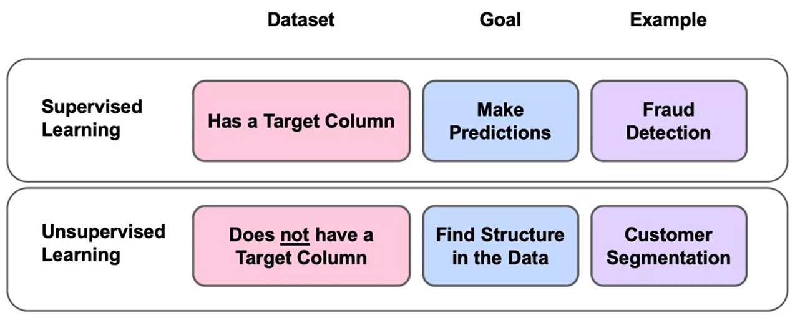
Remind: Supervised Learning

Slide 4
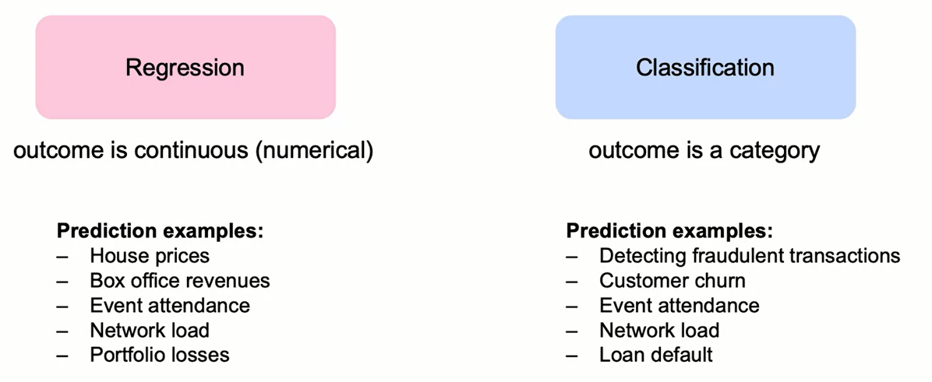
Types of Supervised Learning

Slide 5
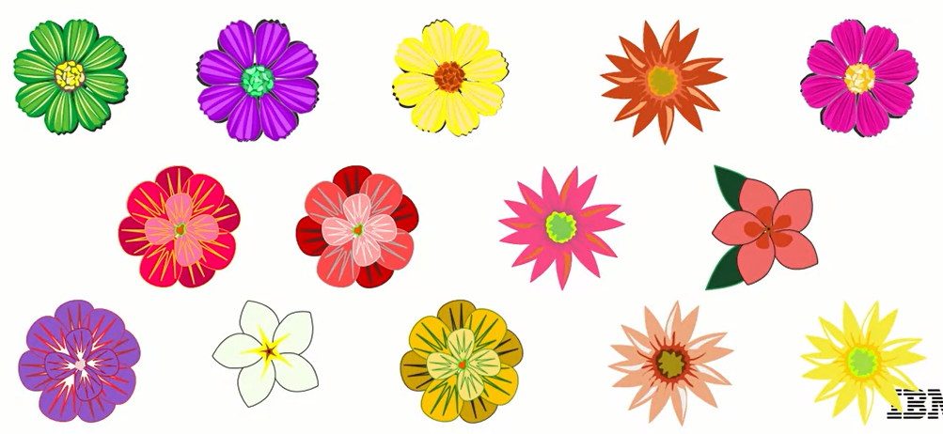
What is Classification
A flower shop wants to guess a customer's purchase from similarity to most recent purchase.

Slide 6
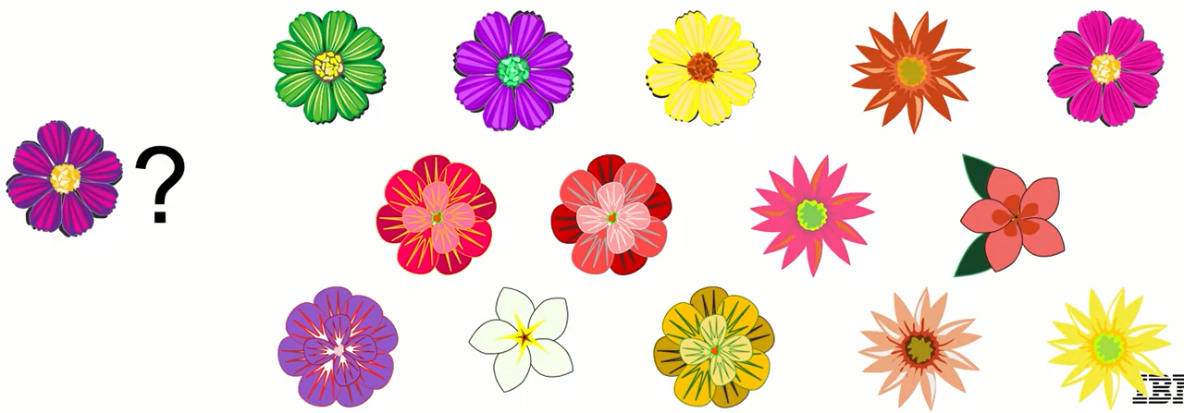
What is Classification
Which flower is a customer most likely to purchase based on similarity to previous purchase?

Slide 7
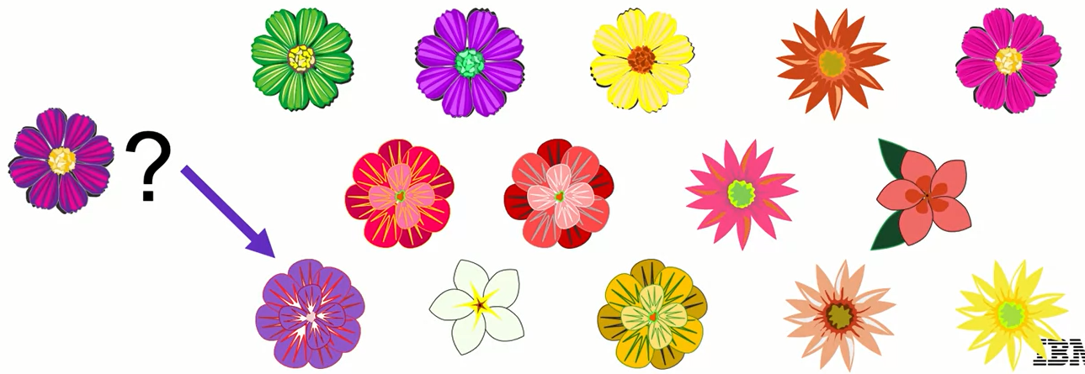
What is Classification
Which flower is a customer most likely to purchase based on similarity to previous purchase?

Slide 8
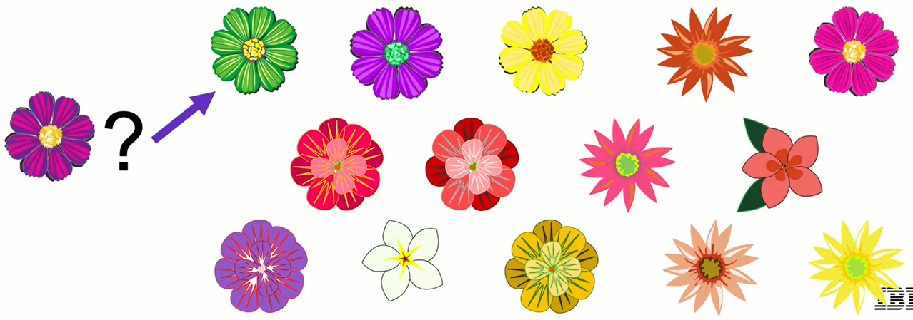
What is Classification
Which flower is a customer most likely to purchase based on similarity to previous purchase?

Slide 9
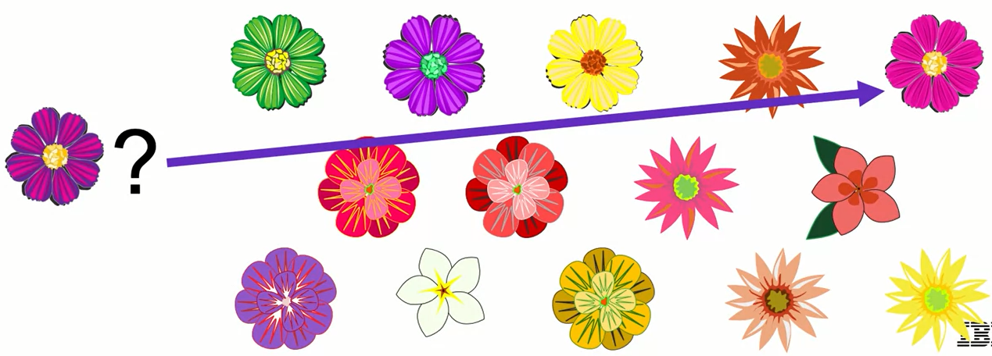
What is Classification
Which flower is a customer most likely to purchase based on similarity to previous purchase?

Slide 10
What is Needed for Classification?
– Model data with:
• Features that can be quantified
• Labels that are known
- Method to measure similarity

Slide 11
Modeling Classification:
Examples of models used for Supervised Learning: Classification:
- Logistic Regression
- K-Nearest Neighbors
- Support Vector Machines
- Neural Networks
- Decision Tree
- Random Forests
- Boosting
- Ensemble Models
Each of these models can be used for both regression and classification.

Slide 12
Learning Recap
In this section, we discussed:
- Types of Supervised Learning (Regression and Classification)
- What is needed for Classification
- Overview of models commonly used for Classification

Slide 13
Introduction to Logistic Regression Learning Goals
In this section, we will cover:
- Introduction to Logistic Regression
- Linear Regression vs. Logistic Regression
- Using Logistic Regression for Classification

Slide 14
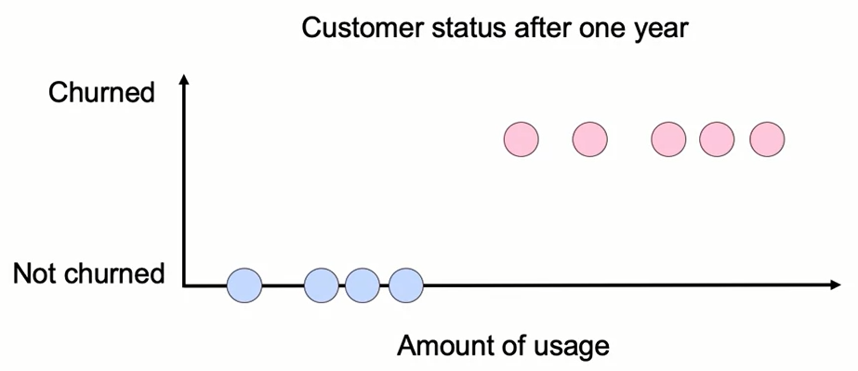
Introduction to Logistic Regression

Slide 15
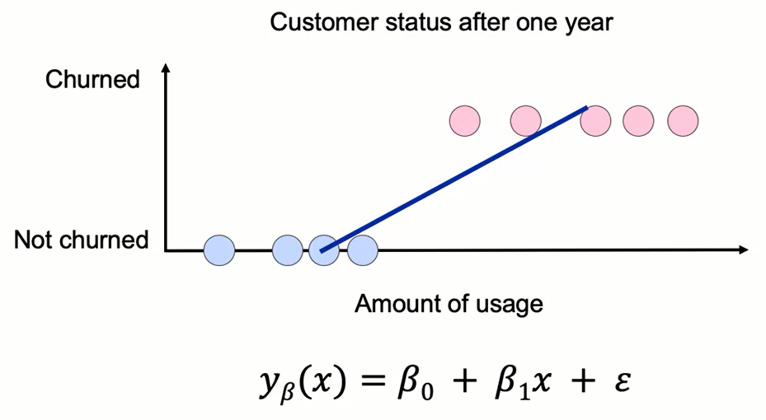
Introduction to Logistic Regression

Slide 16
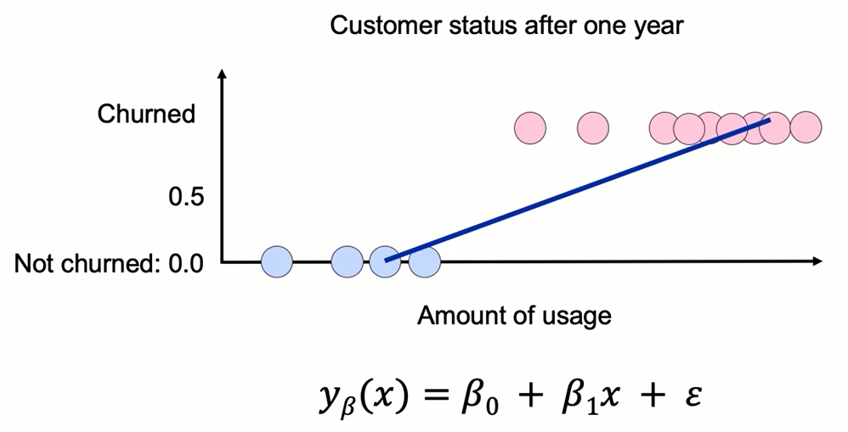
Linear Regression for Classification?

Slide 17
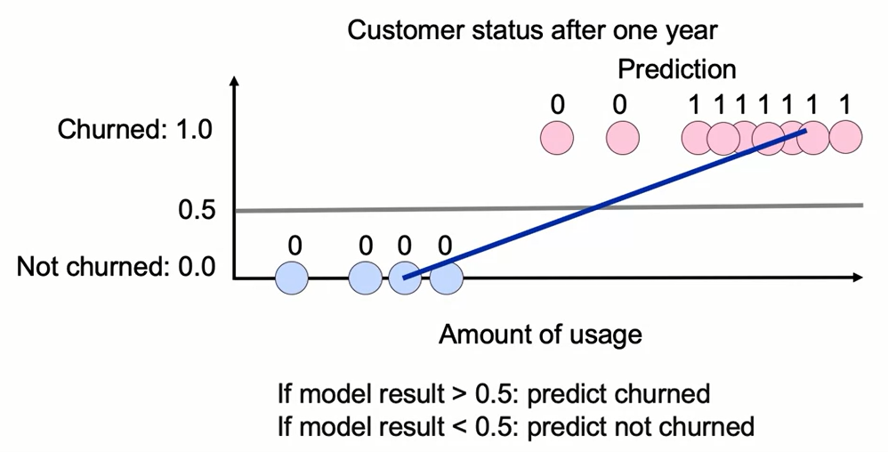
Linear Regression for Classification?

Slide 18
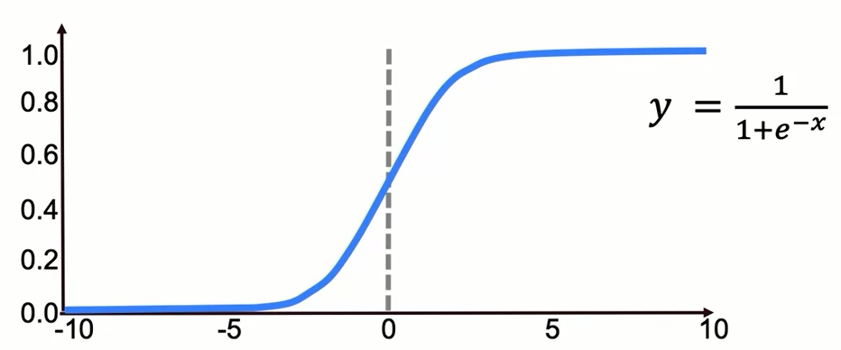
Introducing the Sigmoid Function

Slide 19
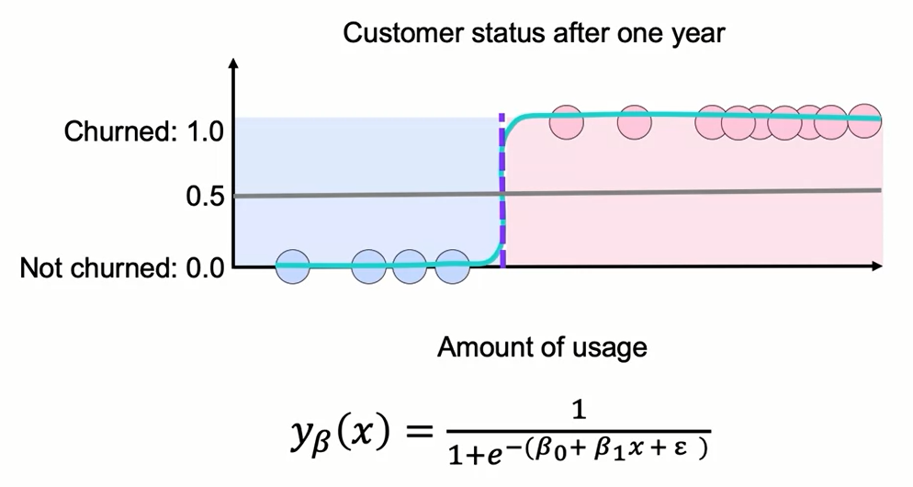
Linear Regression for Classification?

Slide 20
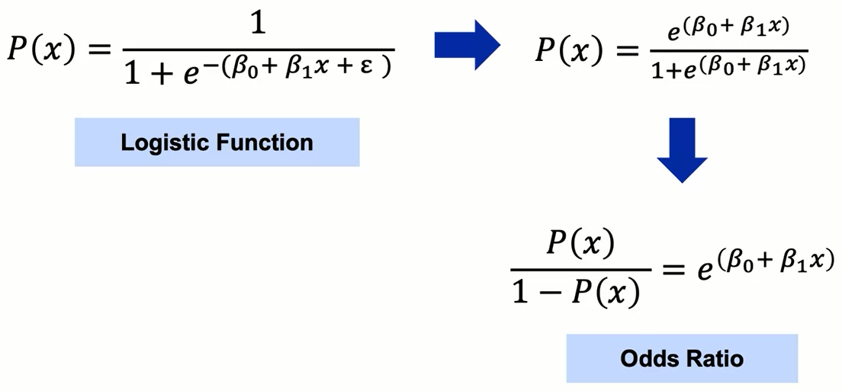
Logistic vs. Linear Regression

Slide 21
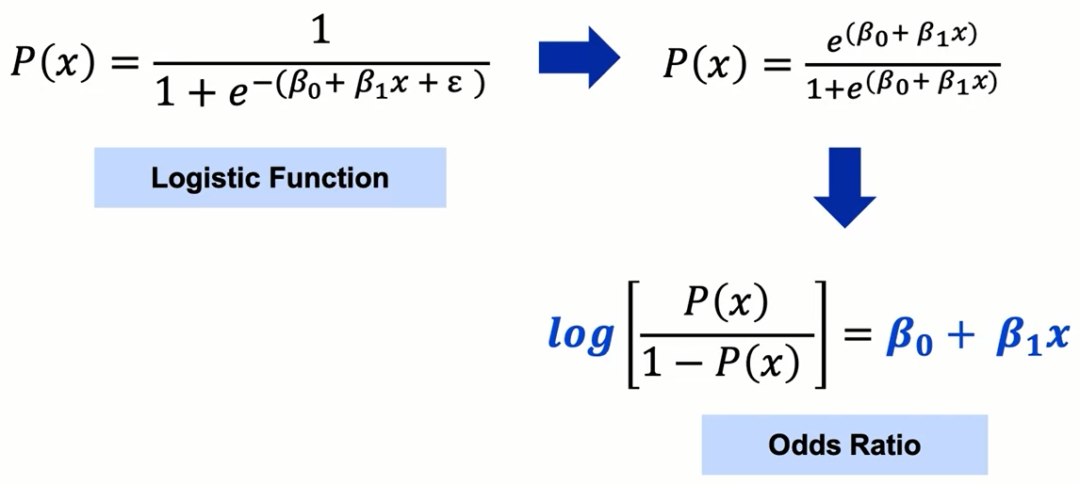
Logistic vs. Linear Regression

Slide 22
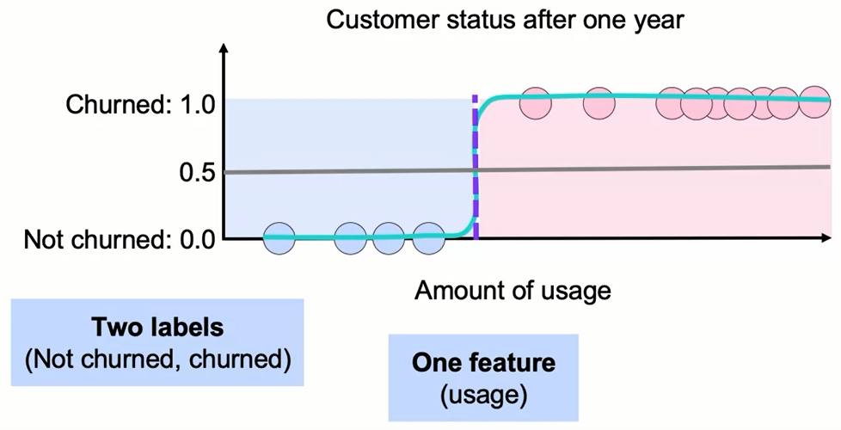
Classification with Logistic Regression

Slide 23
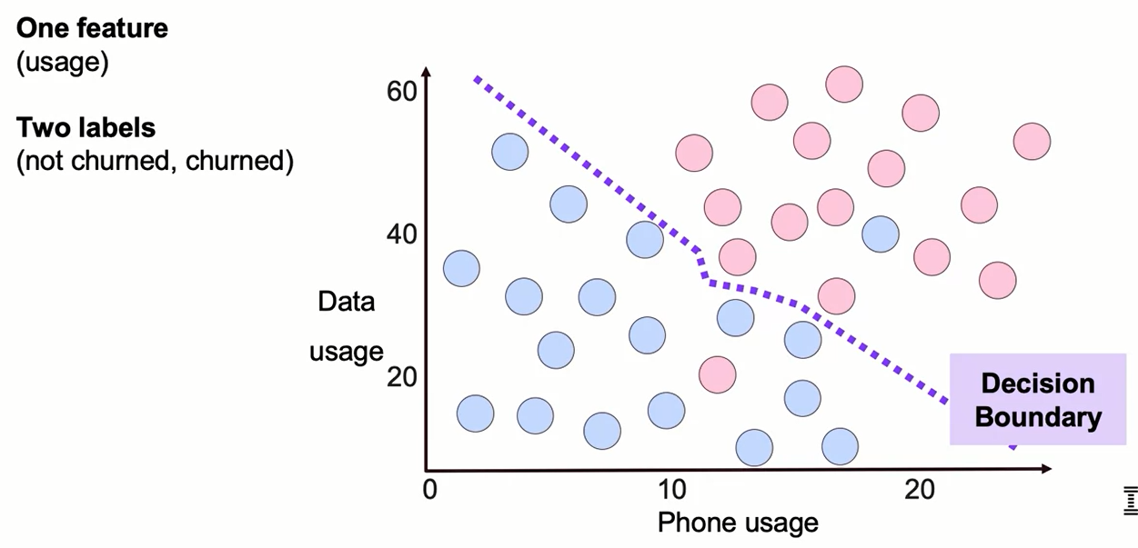
Classification with Logistic Regression

Slide 24
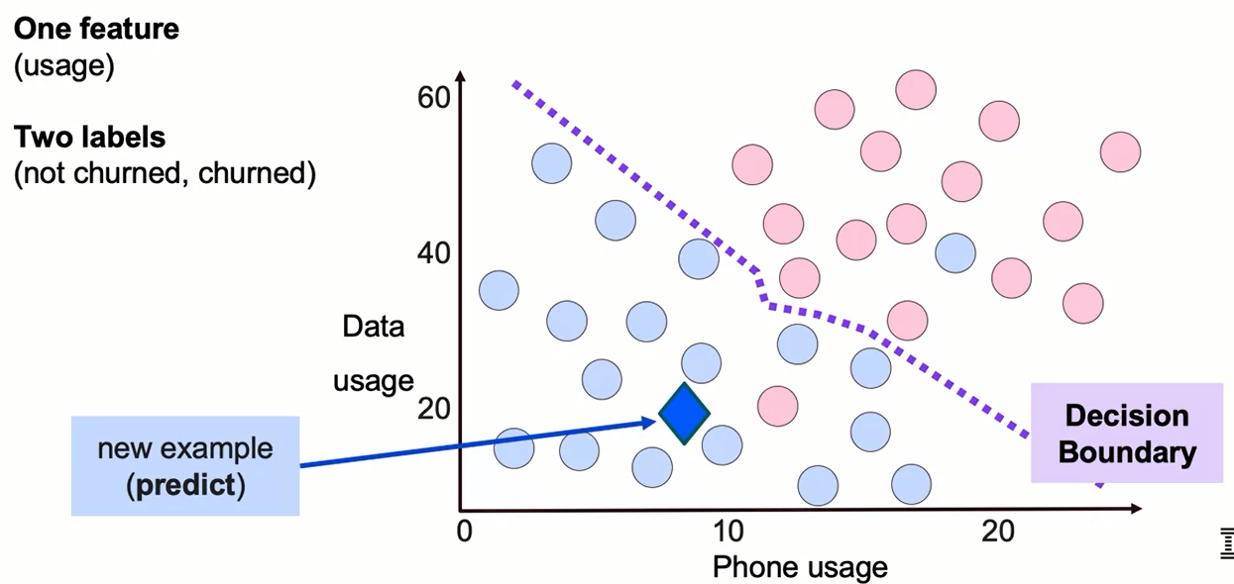
Classification with Logistic Regression

Slide 25
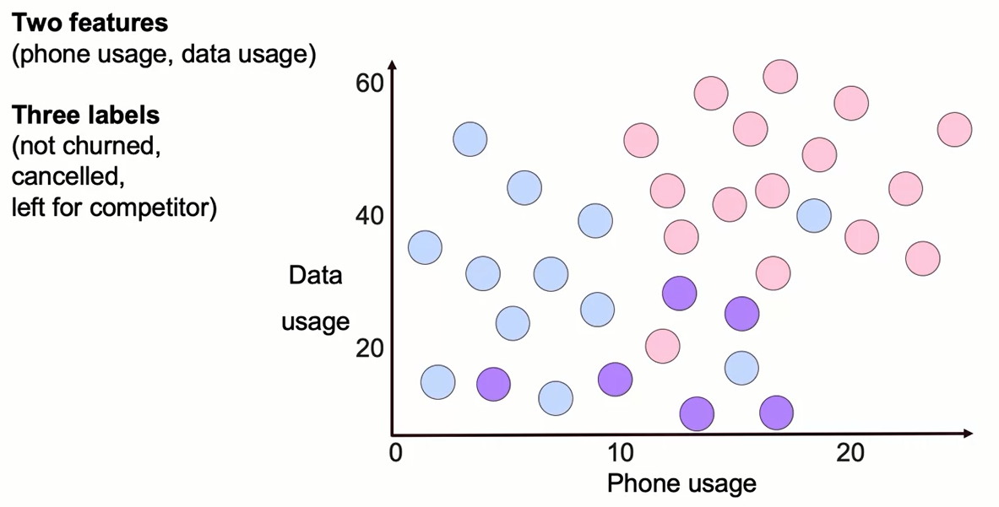
Classification with Logistic Regression

Slide 26
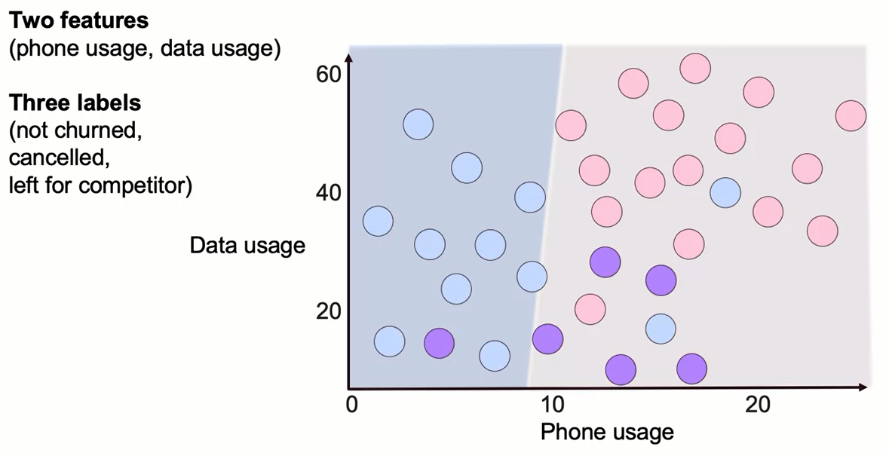
Multiple Classes: One vs. All

Slide 27
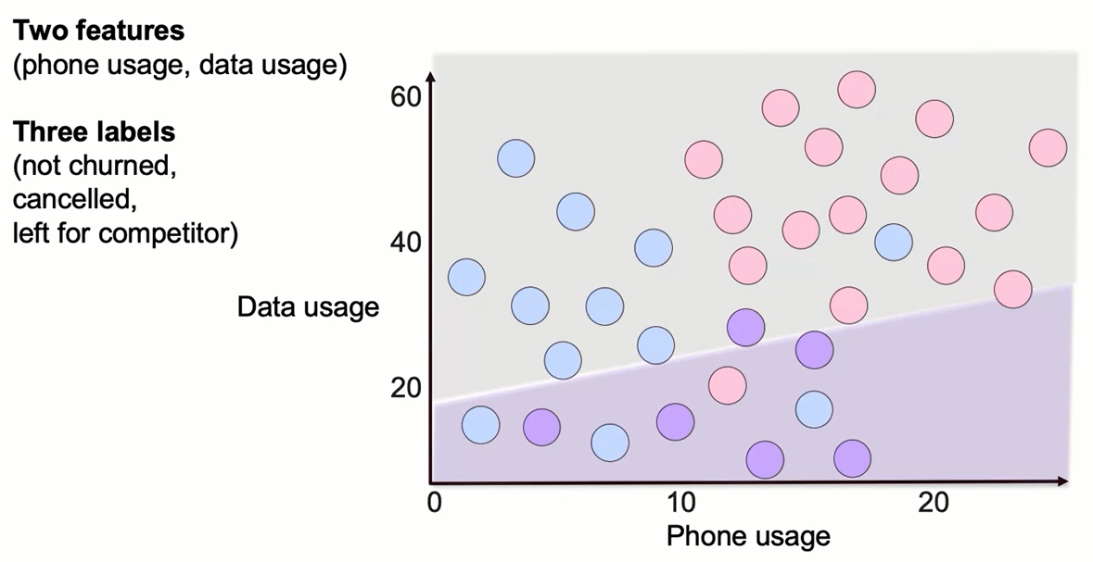
Multiple Classes: One vs. All

Slide 28
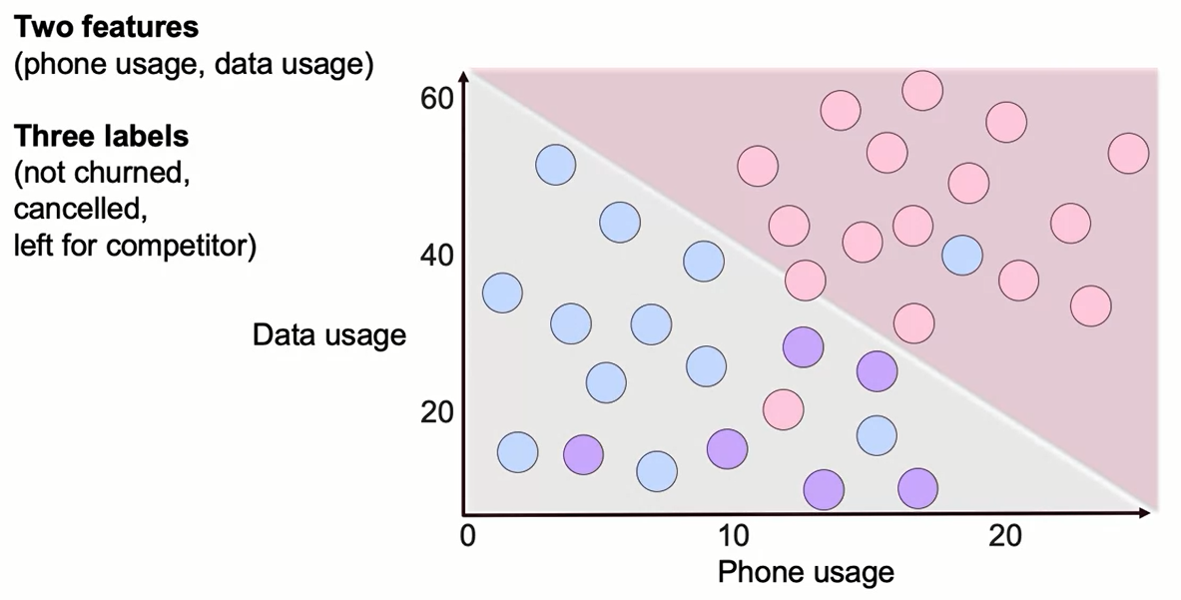
Multiple Classes: One vs. All

Slide 29
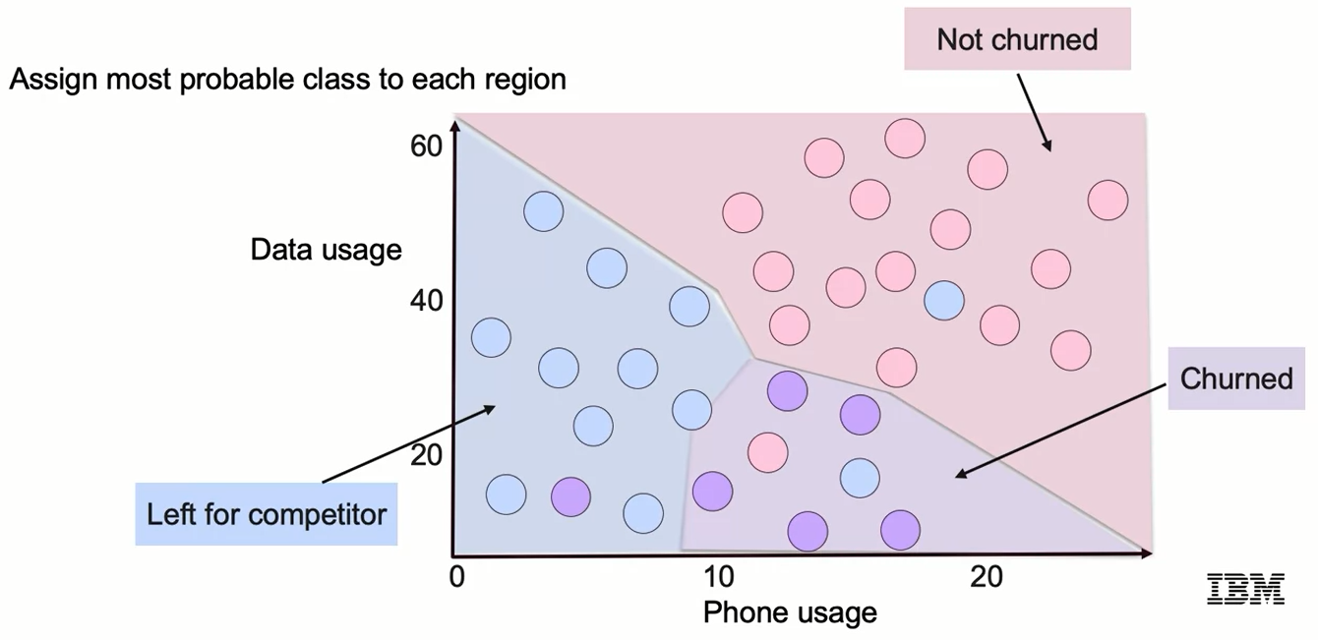
Multiclass Decision Boundary

Slide 30
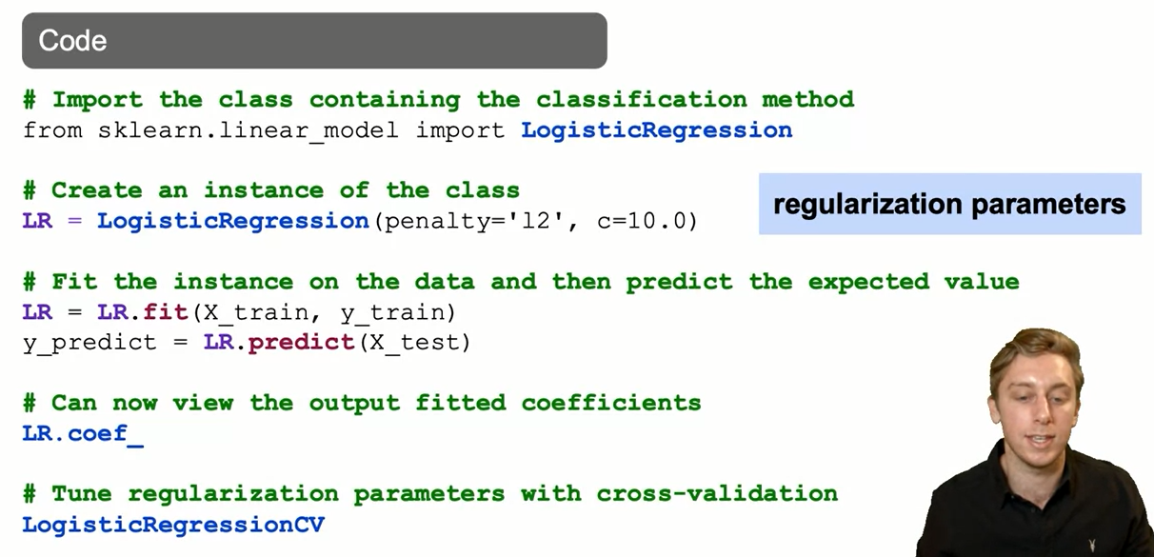
Logistic Regression: The Syntax

Slide 31
Classification with Logistic Regression
Applications for Logistic Regression:
- Customer spending: How likely is a customer is to be a top 5% spender, using previous purchase data
- Customer engagement: which customers are most likely to engage in the next 6 months
- e-commerce: which transactions are fraudulent, using customer characteristics, location, IP address, etc.
- Finance/risk: Predicting whether a loan will default
Interpretation vs. prediction:
- In addition to prediction, we may want to evaluate the importance of each factor in influencing outcomes

Slide 32
Summary
Classification Problems
The two main types of supervised learning models are:
Regression models, which predict a continuous outcome
Classification models, which predict a categorical outcome.
The most common models used in supervised learning are:
Logistic Regression
K-Nearest Neighbors
Support Vector Machines
Decision Tree
Neural Networks
Random Forests
Boosting
Ensemble Models

Slide 33
Summary
Classification Problems
With the exception of logistic regression, these models are commonly used for both regression and classification. Logistic regression is most common for dichotomous and nominal dependent variables.
Logistic Regression
Logistic regression is a type of regression that models the probability of a certain class occurring given other independent variables.It uses a logistic or logit function to model a dependent variable. It is a very common predictive model because of its high interpretability.

Slide 34
Learning Recap
In this section, we discussed:
- Introduction to Logistic Regression
- Linear Regression vs. Logistic Regression
- Using Logistic Regression for Classification

